Slide 1
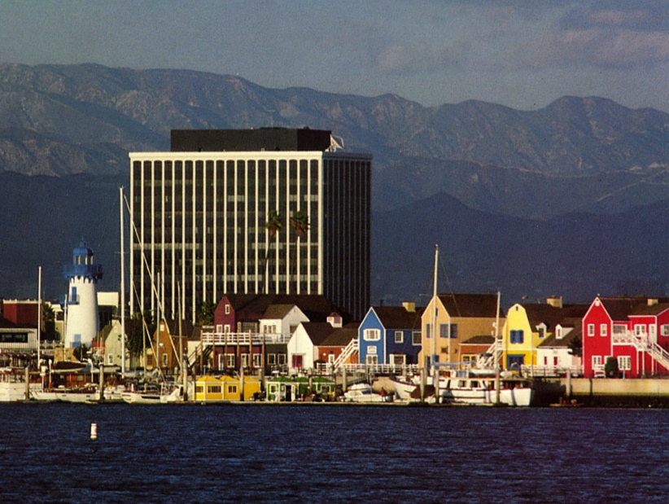
AAAI 2018 Tutorial Building Knowledge Graphs
Craig Knoblock
University of Southern California

Slide 2
Wrappers for Web Data Extraction

Slide 3
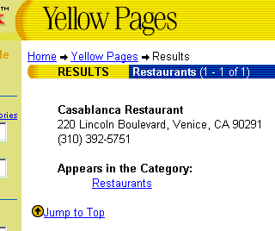
Extracting Data from Semi-structured Sources
NAME Casablanca Restaurant
STREET 220 Lincoln Boulevard
CITY Venice
PHONE (310) 392-5751
Notes:
As the quantity and diversity of the information available online increases, more of the common information access tasks are done by program such as web wrappers. Wrappers faciliate access to Web-based information sources by providing a uniform querying and data extraction capability. For example, a Web wrapper for the yellow pages source can take a query for a Mexican restaurant near Marina del Rey, CA, and extract the restaurant’s name, its address and the phone number, in the same way as the information is extracted from a database.

Slide 4
Approaches to Wrapper Construction
Manual Wrapper Construction
Learning Wrappers from Labelled Examples
Grammar Induction for Automatic Wrapper Construction

Slide 5
Grammar Induction Approach
Pages automatically generated by scripts that encode results of db query into HTML
Script = grammar
Given a set of pages generated by the same script
Learn the grammar of the pages
Wrapper induction step
Use the grammar to parse the pages
Data extraction step

Slide 6
RoadRunner [Crescenzi, Mecca, & Merialdo]
Automatically generates a wrapper from large web pages
Pages of the same class
No dynamic content from javascript, ajax, etc
Infers source schema
Supports nested structures and lists
Extracts data from pages
Efficient approach to large, complex pages with regular structure
Notes:
“given a set of sample HTML pages belonging to the same class, find the nested type of the source dataset and extract the source dataset from which the
pages have been generated.”

Slide 7
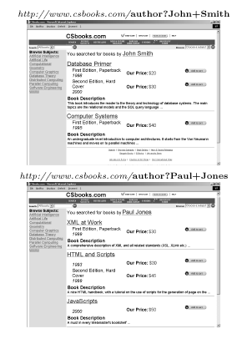
Example Pages
Compares two pages at a time to find similarities and differences
Infers nested structure (schema) of page
Extracts fields

Slide 8
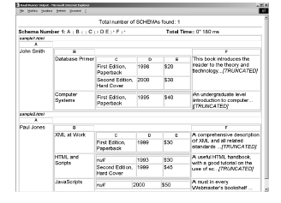
Extracted Result

Slide 9
Union-Free Regular Expression (UFRE)
Web page structure can be represented as Union-Free Regular Expression (UFRE)
UFRE is Regular Expressions without disjunctions
If a and b are UFRE, then the following are also UFREs
a.b
(a)+
(a)?

Slide 10
Union-Free Regular Expression (UFRE)
Web page structure can be represented as Union-Free Regular Expression (UFRE)
UFRE is Regular Expressions without disjunctions
If a and b are UFRE, then the following are also UFREs
a.b → string fields
(a)+ → lists (possibly nested)
(a)? → optional fields
Strong assumption that usually holds

Slide 11
Approach
Given a set of example pages
Generate the Union-Free Regular Expression which contains example pages
Find the least upper bounds on the RE lattice to generate a wrapper in linear time
Reduces to finding the least upper bound on two UFREs

Slide 12
Matching/Mismatches
Given a set of pages of the same type
Take the first page to be the wrapper (UFRE)
Match each successive sample page against the wrapper
Mismatches result in generalizations of wrapper
String mismatches
Tag mismatches

Slide 13
Matching/Mismatches
Given a set of pages of the same type
Take the first page to be the wrapper (UFRE)
Match each successive sample page against the wrapper
Mismatches result in generalizations of wrapper
String mismatches
Discover fields
Tag mismatches
Discover optional fields
Discover iterators

Slide 14
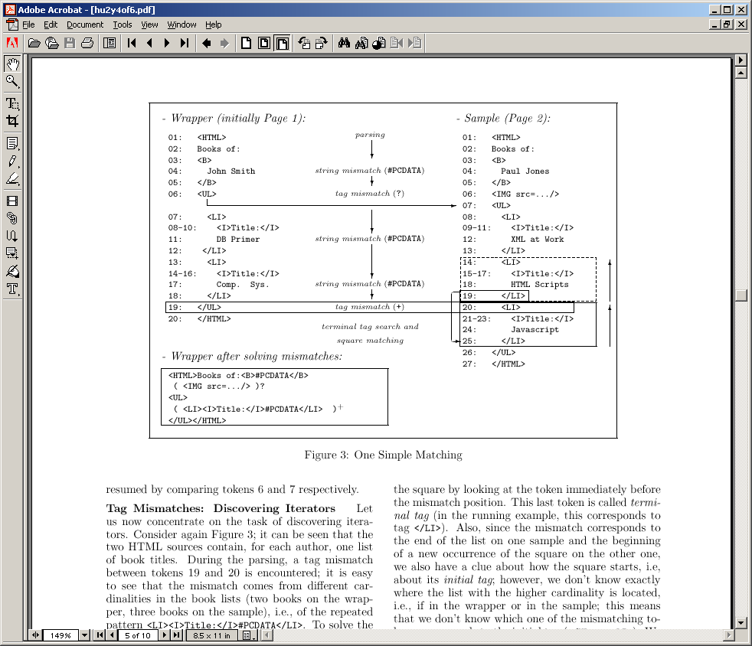
Example Matching
Notes:
Matching algorithm parses the sample using the wrapper. Mismatch happens when a token in the sample does not correspond to toke nin the wrapper.

Slide 15
String Mismatches: Discovering Fields
String mismatches are used to discover fields of the document
Wrapper is generalized by replacing “John Smith” with #PCDATA
<HTML>Books of: <B>John Smith
→ <HTML> Books of: <B>#PCDATA

Slide 16
Example Matching

Slide 17
Tag Mismatches: Discovering Optionals
First check to see if mismatch is caused by an iterator (described next)
If not, could be an optional field in wrapper or sample
Cross search used to determine possible optionals
Image field determined to be optional:
( <img src=…/>)?

Slide 18
Example Matching
String Mismatch
String Mismatch

Slide 19
Tag Mismatches: Discovering Iterators
Assume mismatch is caused by repeated elements in a list
End of the list corresponds to last matching token: </LI>
Beginning of list corresponds to one of the mismatched tokens: <LI> or </UL>
These create possible “squares”
Match possible squares against earlier squares
Generalize the wrapper by finding all contiguous repeated occurrences:
( <LI><I>Title:</I>#PCDATA</LI> )+

Slide 20
Example Matching

Slide 21
Internal Mismatches
Generate internal mismatch while trying to match square against earlier squares on the same page
Solving internal mismatches yield further refinements in the wrapper
List of book editions
<I>Special!</I>

Slide 22
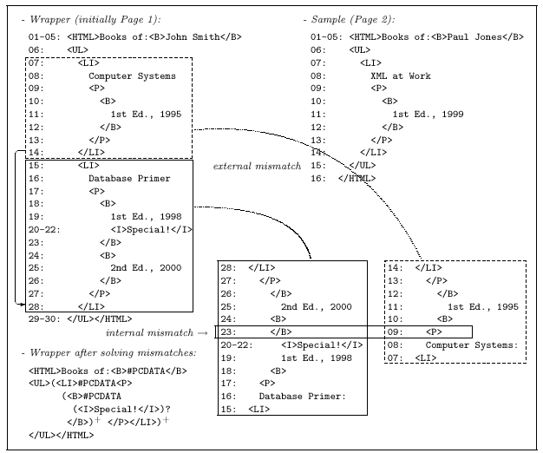
Recursive Example

Slide 23
Discussion
Assumptions:
Pages are well-structured
Structure can be modeled by UFRE (no disjunctions)
Search space for explaining mismatches is huge
Uses a number of heuristics to prune space
Limited backtracking
Limit on number of choices to explore
Patterns cannot be delimited by optionals
Will result in pruning possible wrappers

Slide 24
Limitations
Learnable grammars
Union-Free Regular Expressions (RoadRunner)
Variety of schema structure: tuples (with optional attributes) and lists of (nested) tuples
Does not efficiently handle disjunctions – pages with alternate presentations of the same attribute
Context-free Grammars
Limited learning ability
User needs to provide a set of pages of the same type

Slide 25
Inferlink Web Extraction Software

Slide 26
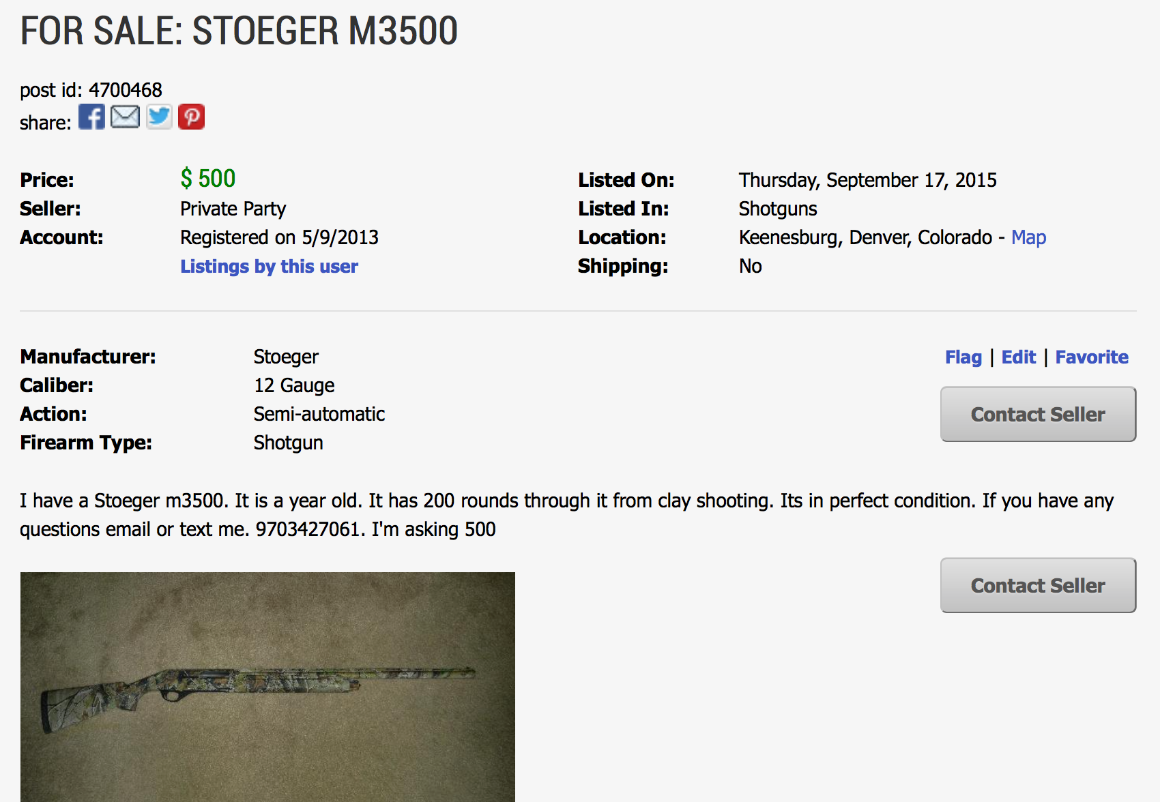
Extraction

Slide 27
Structured Extraction

Slide 28
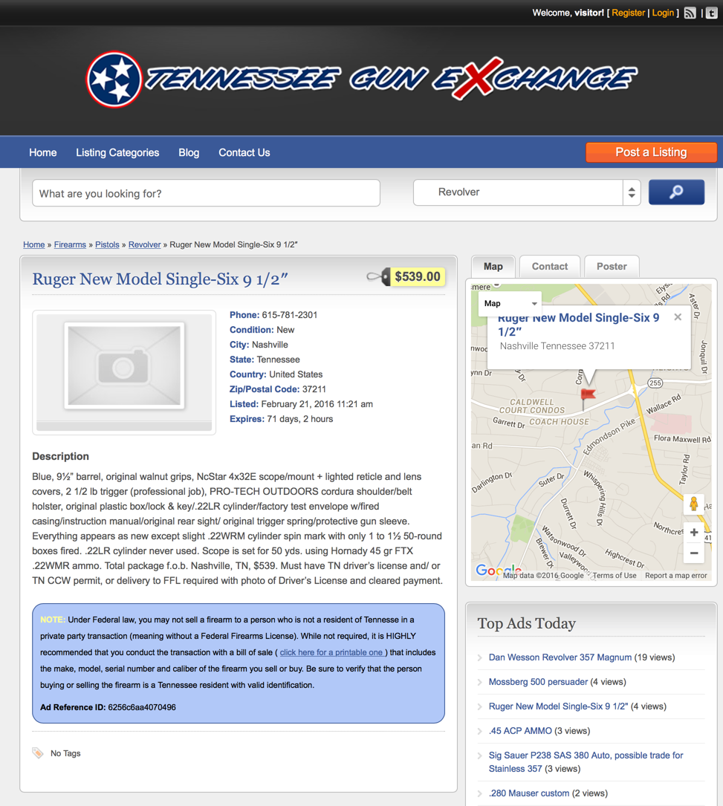
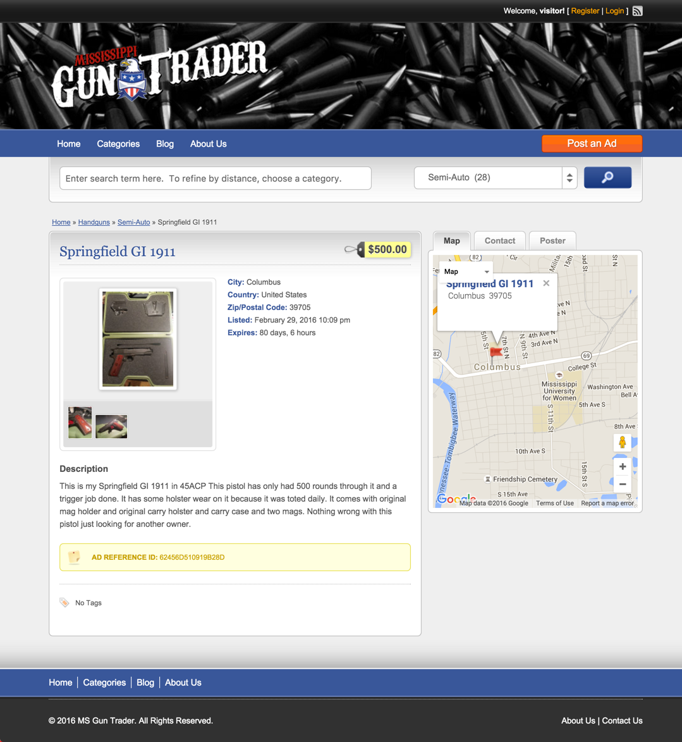
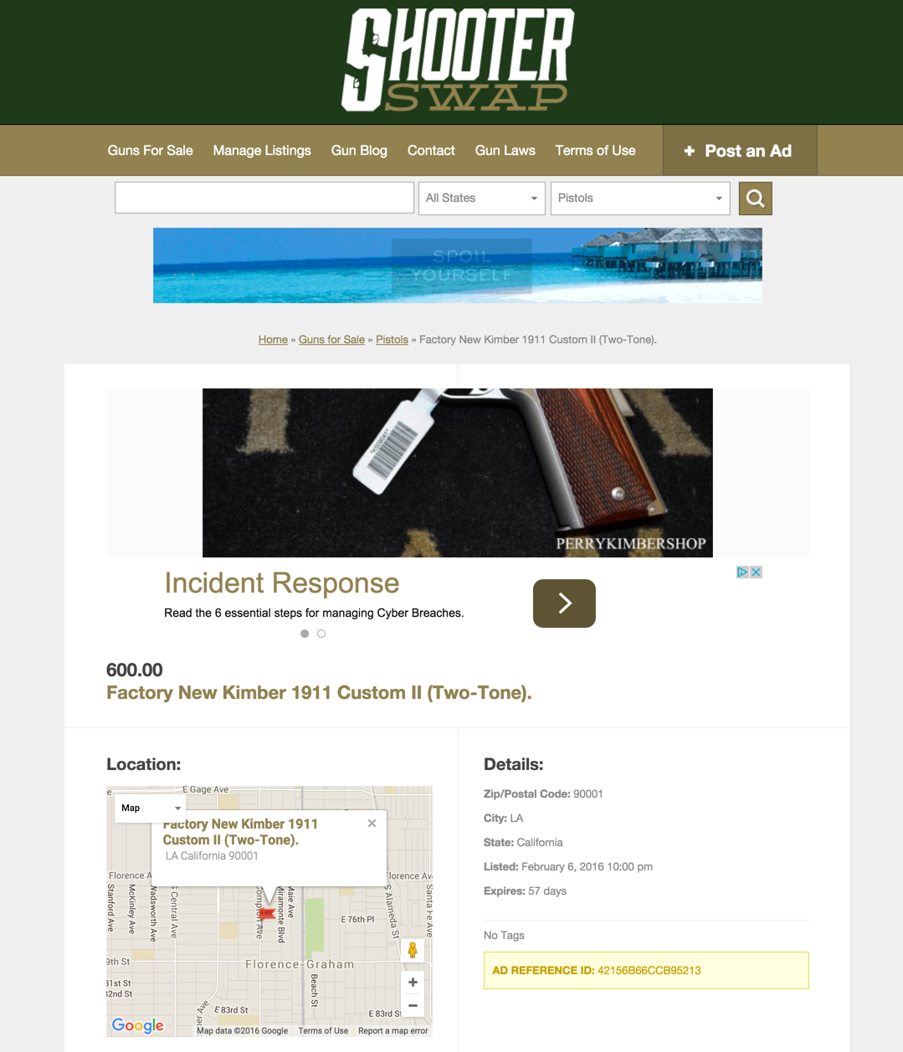
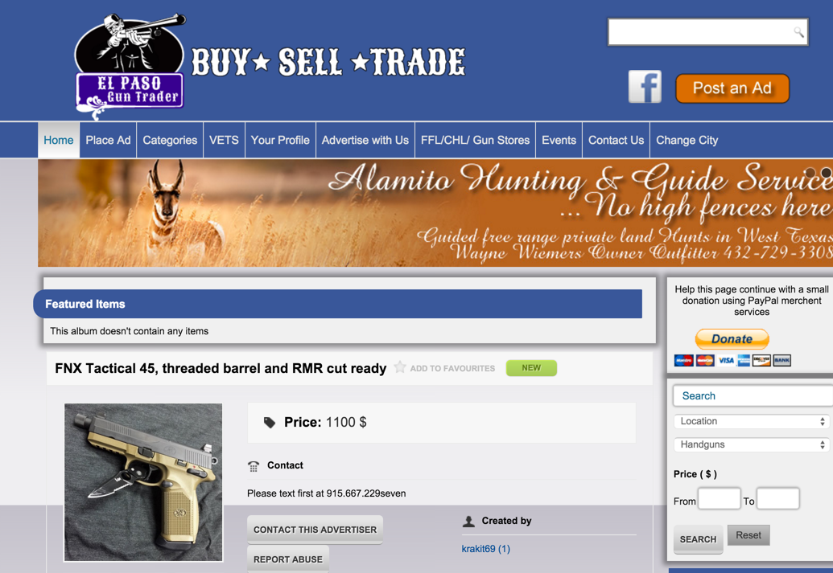
Automated Extraction [Minton et al., Inferlink]
Title
Description
Seller
Post Date
Expiry Date
Price
Location
Category
Member Since
Num Views
Post ID

Slide 29
Automated Extraction
Input: A Pile of Pages

Slide 30
Automated Extraction
Classify by
Templates
input:
a pile of pages
pages clustered
by template

Slide 31
Clustering
Cluster
Based on the visible text
Page is broken into chunks
These are continuous blocks of text
Search for common visible chunks
Remove chunks that occur in all pages
Remove those that occur in fewer than 10 pages
Greedy algorithm to cluster the pages based on the remaining chunks
Sort by the size of the clusters created by each chunk

Slide 32
Automated Extraction
Infer
Extractor
Infer
Extractor
Classify by
Templates
Infer
Extractor
Infer
Extractor
input:
a pile of pages
pages clustered
by template
extractor

Slide 33
Extractor Learning
Input: cluster
Select 5 random pages to build a template
Tokenize on space & punctuation
Start with n-grams of tuples of size n
Find those n-grams that occur on all pages
Keep only those n-grams that occur exactly once per page
Decompose pages based on these n-grams
Run algorithm recursively on decomposed page
Repeat above for size n-1 down to n=2
Construct template based on the decomposition

Slide 34
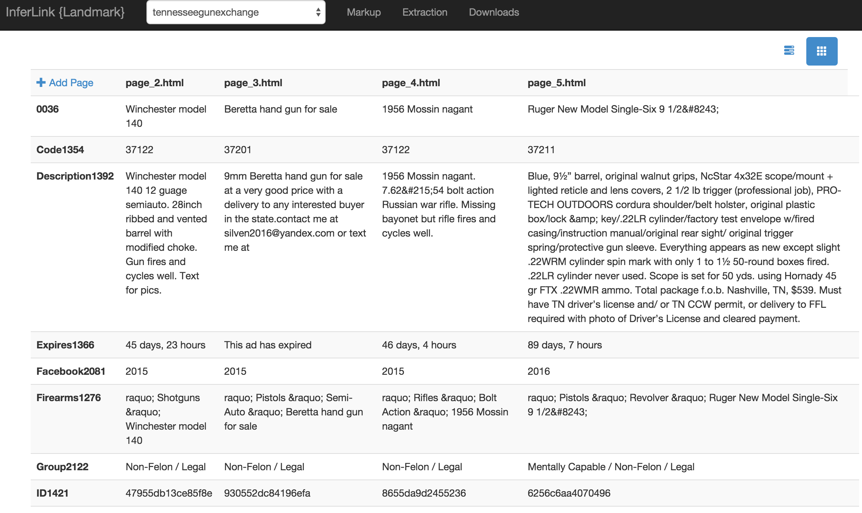
Unsupervised Extraction Tool

Slide 35
Extraction Evaluation
10 websites, 5 pages each
fields
 | Title | Desc | Seller | Date | Price | Loc | Cat | Member Since | Expires | Views | ID
Perfect | 1.0 (50/50) | .76 (37/49) | .95 (40/42) | .83 (40/48) | .87 (39/45) | .51 (23/45) | .68 (34/50) | 1.0 (35/35) | .52 (15/29) | .76 (19/25) | .97 (35/36)
Including partial and extra data | 1.0 (50/50) | .98 (48/49) | .95 (40/42) | .83 (40/48) | .98 (44/45) | .84 (38/45) | .88 (44/50) | 1.0 (35/35) | .55 (16/29) | 1.0 (25/25) | 1.0 (36/36)

Slide 36
Discussion
Inferlink approach solves some of the key limitations of Roadrunner
Pages do not all have to be of the same type
Multiple optionals would be treated as different page types
Scales well with complex pages

Slide 37
Web Data Extraction Software
Beautiful Soup
http://www.crummy.com/software/BeautifulSoup/
Python library to manually write wrappers
Jsoup
http://jsoup.org/
Java library to manually write wrappers
ScrapingHub
http://scrapinghub.com/
Portia provides a wrapper learner
Others
https://www.quora.com/Which-are-some-of-the-best-web-data-scraping-tools
Tell us if you find a good one!

Slide 38
Aligning and Integrating Data in Karma

Slide 39


Karma
Interactive tool for rapidly extracting, cleaning, transforming, integrating and publishing data
Tabular
Sources
RDF
Database
Hierarchical Sources
Karma
CSV
Services
…
http://www.isi.edu/integration/karma
@KarmaSemWeb

Slide 40
Information Integration in Karma
Karma
semi-automatically generates Source Mappings
Domain Model
Karma
Source Mappings
Samples of Source Data

Slide 41
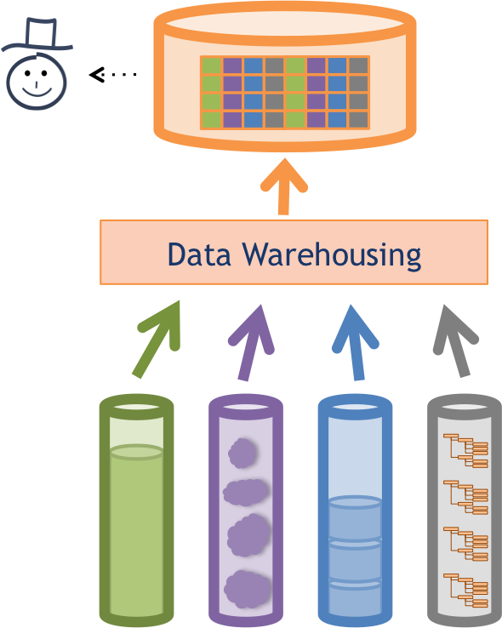
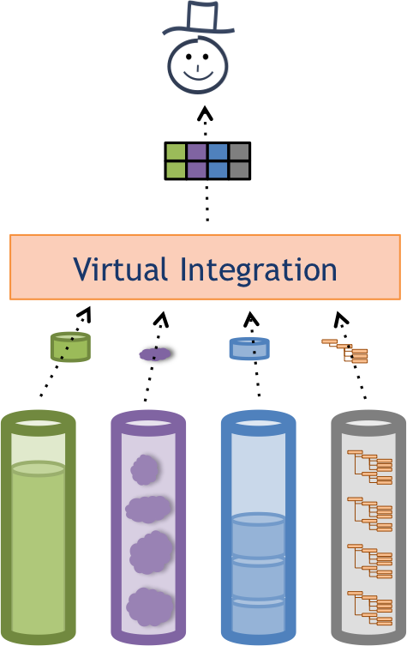
Information Integration in Karma
Karma
semi-automatically generates Source Mappings
Domain Model
Karma
Source Mappings
Samples of Source Data
Karma
supports multiple integration regimes

Slide 42
Secret Sauce: Karma Understands Your Data
Semantic Model
of the Data
Domain Model
Karma
Source Mappings
Samples of Source Data
Karma semi-automatically builds a semantic model of your data

Slide 43
What is a Semantic Model?
Describe sources using classes & relationships in an ontology
Source
 | name | date | city | state | workplace
1 | Fred Collins | Oct 1959 | Seattle | WA | Microsoft
2 | Tina Peterson | May 1980 | New York | NY | Google
bornIn
nearby
birthdate
livesIn
isPartOf
Place
Person
name
organizer
location
postalCode
name
ceo
City
State
worksFor
Event
state
Domain
Model
Organization
title
endDate
phone
object property
startDate
data property
name
subClassOf

Slide 44
Semantic Types
Person
Person
City
State
Organization
name
birthdate
name
name
name
 | name | date | city | state | workplace
1 | Fred Collins | Oct 1959 | Seattle | WA | Microsoft
2 | Tina Peterson | May 1980 | New York | NY | Google

Slide 45
Relationships
worksFor
bornIn
state
Person
City
State
Organization
name
birthdate
name
name
name
 | name | date | city | state | workplace
1 | Fred Collins | Oct 1959 | Seattle | WA | Microsoft
2 | Tina Peterson | May 1980 | New York | NY | Google

Slide 46
Semantic Model
worksFor
bornIn
state
Person
City
State
Organization
name
birthdate
name
name
name
 | name | date | city | state | workplace
1 | Fred Collins | Oct 1959 | Seattle | WA | Microsoft
2 | Tina Peterson | May 1980 | New York | NY | Google
Semantic models will be formalized as Source Mappings
Key ingredient to automate source discovery, data integration, and publishing semantic data (RDF triples)

Slide 47
Knowledge
Graphs
Karma uses semantic models to create knowledge graphs

Slide 48
Karma semi-automatically builds semantic models
Knowledge
Graphs
Karma uses semantic models to create knowledge graphs

Slide 49
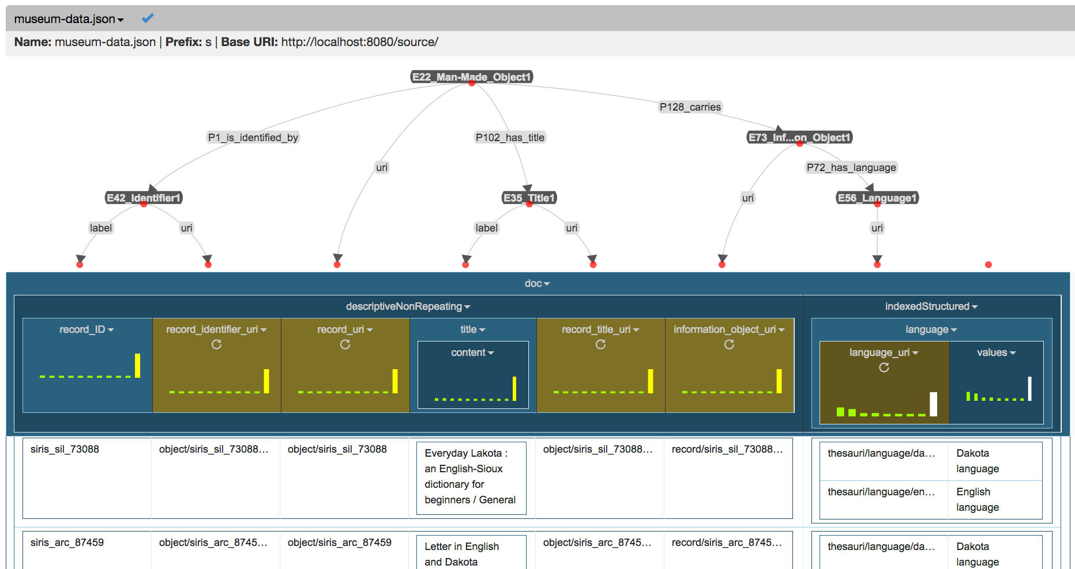
Karma semi-automatically builds semantic models
… and provides a nice GUI to edit them
Knowledge
Graphs
Karma uses semantic models to create knowledge graphs

Slide 50
Semi-automatically Building Semantic Models in Karma

Slide 51


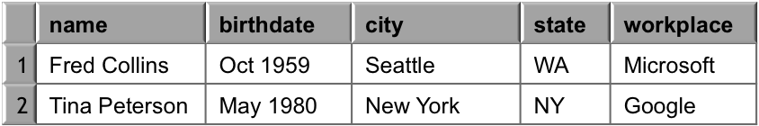
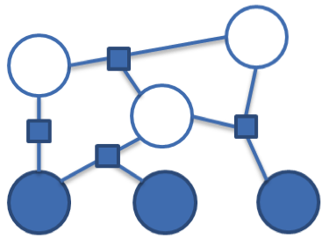
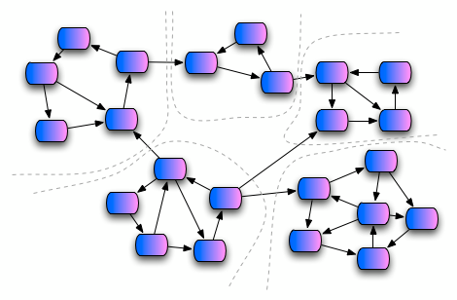
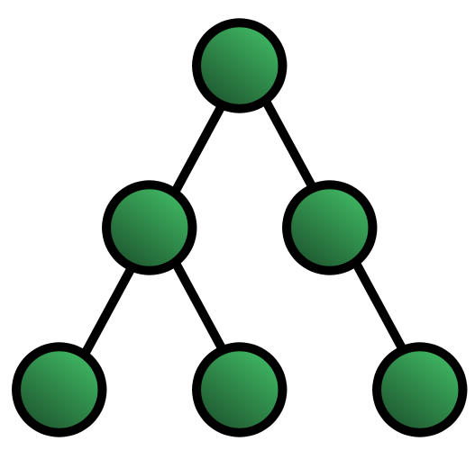
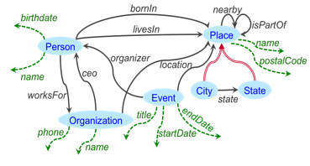
Approach [Knoblock et al, ESWC 2012]
Sample Data
Steiner Tree
Learn
Semantic Types
Extract
Relationships
Construct a Graph
Domain Ontology

Slide 52
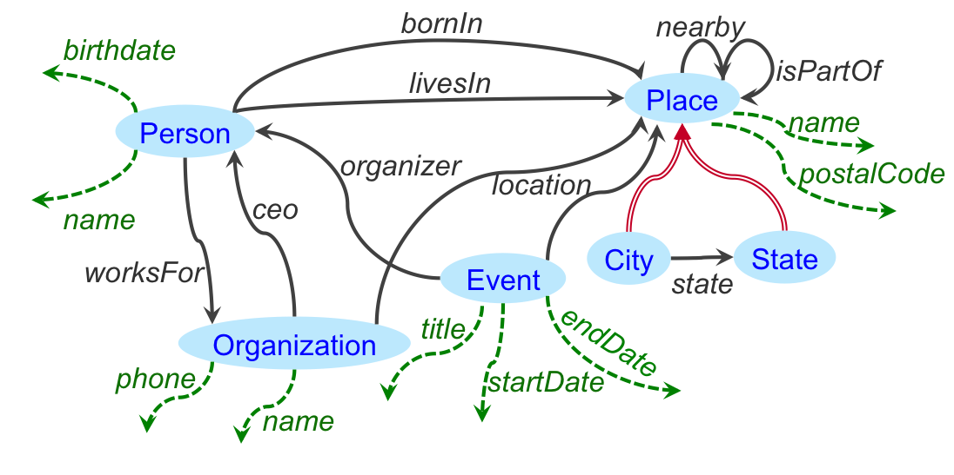
Example
Source
 | name | date | city | state | workplace
1 | Fred Collins | Oct 1959 | Seattle | WA | Microsoft
2 | Tina Peterson | May 1980 | New York | NY | Google
Domain Ontology
object property
data property
subClassOf
Find a semantic model for the source (map the source to the ontology)

Slide 53
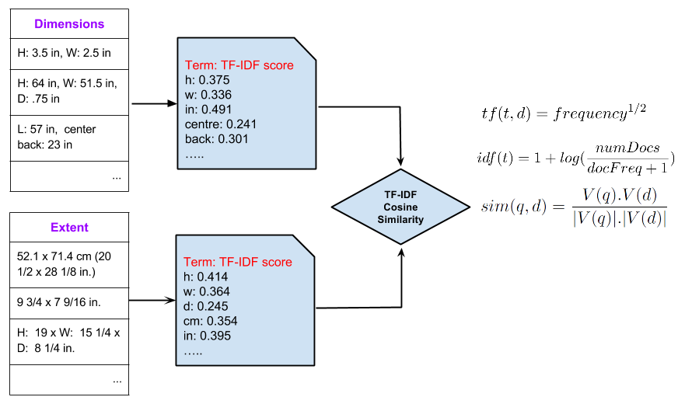
Learning Semantic Types [Krishnamurthy et al., ESWC 2015]
class?
property ?

Slide 54
Learning Semantic Types
CulturalHeritageObject
extent
1- User specifies
2- System learns

Slide 55
Learning Semantic Types
CulturalHeritageObject
extent

Slide 56
Learning Semantic Types
CulturalHeritageObject
CulturalHeritageObject
extent
extent

Slide 57
Requirements
Learn from a small number of examples
Work on both textual and numeric values
Learn quickly and highly scalable to large number of semantic types

Slide 58
Approach for Textual Data
Document: each column of data
Label: each semantic type
Use Apache Lucene to index the labeled documents
Compute TF/IDF vectors for documents
Compare documents using Cosine Similarity between TF/IDF vectors

Slide 59
Approach for Textual Data

Slide 60
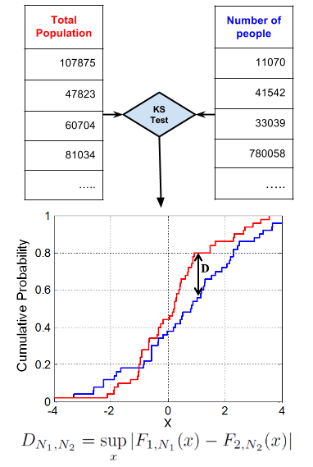
Approach for Numeric Data
Distribution of values in different semantic types is different, e.g., temperature vs. population
Use Statistical Hypothesis Testing to see which distribution fits best
Welch’s T-test, Mann-Whitney U-test and Kolmogorov-Smirnov Test

Slide 61
Approach for Numeric Data
Notes:
In inferential statistics the null hypothesis usually refers to a general statement or default position that there is no relationship between two measured phenomena, or no difference among groups.
Two-sample test checks whether the two data samples come from the same distribution.

Slide 62
Similarity features
Similiarity Features
Attribute names similarity
Jaccard
Value Similarity
TF-IDF
Distribution Similarity
Jaccard
Mann-Whitney test
Kolmogorov-Smirnov test
Histogram Similarity
Mann-Whitney test

Slide 63
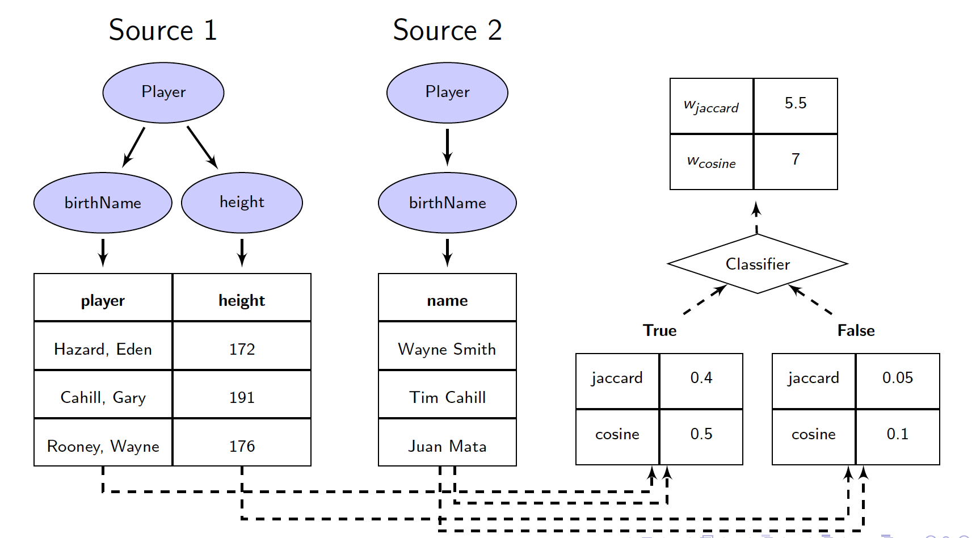
Training machine learning model [Pham et al., ISWC 2016]

Slide 64
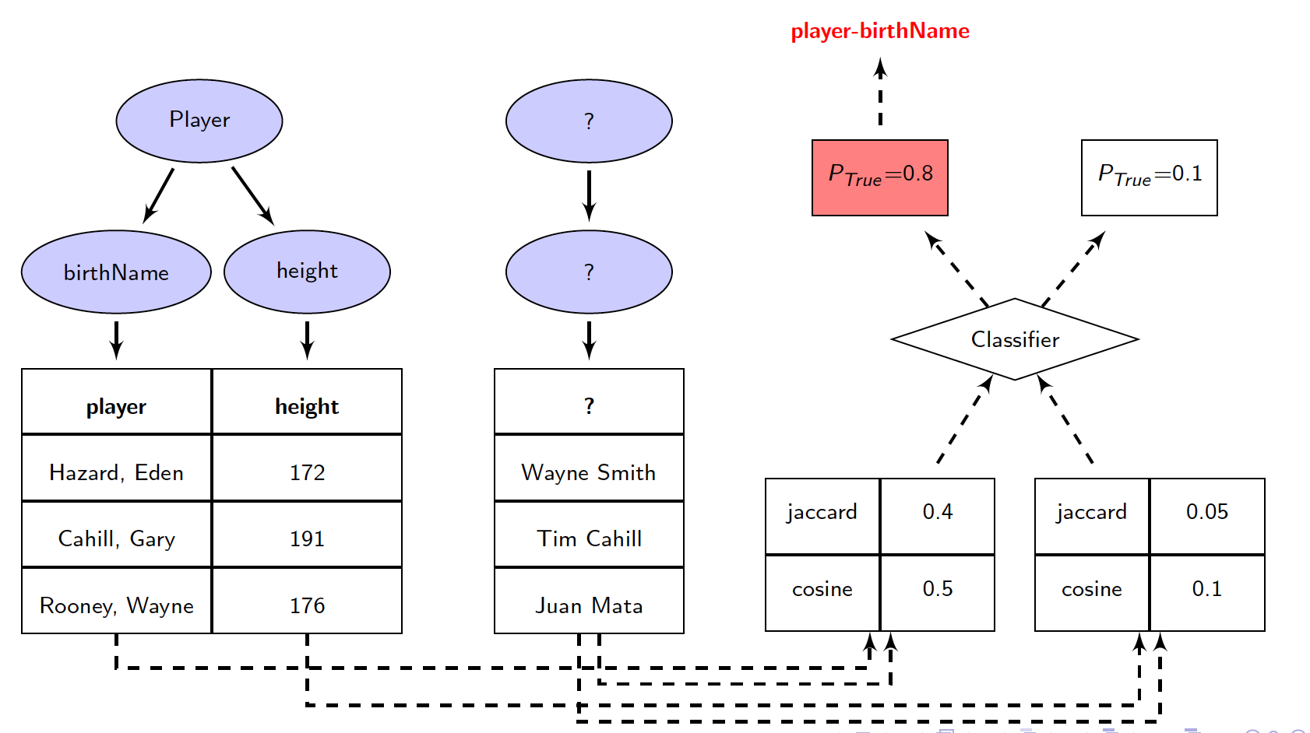
Predicting new attribute

Slide 65
Approach [Knoblock et al, ESWC 2012]
Sample Data
Steiner Tree
Learn
Semantic Types
Extract
Relationships
Construct a Graph
Domain Ontology

Slide 66
Construct a Graph
Construct a graph from semantic types and ontology
Person
Person
City
State
Organization
name
birthdate
name
name
name
 | name | date | city | state | workplace
1 | Fred Collins | Oct 1959 | Seattle | WA | Microsoft
2 | Tina Peterson | May 1980 | New York | NY | Google

Slide 67
Construct a Graph
Construct a graph from semantic types and ontology
date

Slide 68
Inferring the Relationships
Search for minimal explanation
Steiner tree connecting semantic types over ontology graph
Given graph G=(V,E), nodes S ⊂ V, cost c: E →ℜ
Find a tree of G that spans S with minimal total cost
Unfortunately, NP-complete
Approximation Algorithm [Kou et al., 1981]
Worst-case time complexity: O(|V|²|S|)
Approximation Ratio: less than 2

Slide 69
Steiner Tree
V1
1
V1
4
V4
V1
4
V4
V8
V9
1/2
1/2
4
10
V7
1
4
4
4
1
4
V2
1
V6
1
V5
V2
V3
V2
V3
4
4
2
2
1. construct the complete graph (Nodes: Steiner Nodes, Links Weights: shortest path from each pair in original G)
2. Compute MST
8
V3
V4
9
Steiner nodes: {V1, V2, V3, V4}
V1
1
V1
V1
1
1
V9
V8
V9
V8
V9
1/2
1/2
1/2
1/2
1
V7
1
V7
1
V2
1
V6
1
V5
1
V2
1
V6
1
V5
V2
1
V6
1
V5
2
2
2
2
2
V3
V4
2
V3
V4
V3
V4
3. replace each link with the corresponding shortest path in original G
5. remove extra links until
all leaves are Steiner nodes
4. Compute MST
Notes:
In the second step, instead of selecting MST ((v1, v4) – (v1, v2)- (v2-v3)), if we select another MST like ((v1, v4) – (v1, v2)- (v1-v3)), we would get another Steiner tree as result.
MST = Minimum Spanning Tree

Slide 70
Inferring the Relationships
Select minimal tree that connects all semantic types
A customized Steiner tree algorithm
Initial Model
date
Notes:
The exact approximation ratio is: 2 * (1 – 1/l) where l is the number of leaves in optimal tree.
Paper link: http://www.springerlink.com/content/v7w86m72174k7267/
Volume 15, Number 2, 141-145, DOI: 10.1007/BF00288961
A fast algorithm for Steiner trees
L. Kou, G. Markowsky and L. Berman

Slide 71
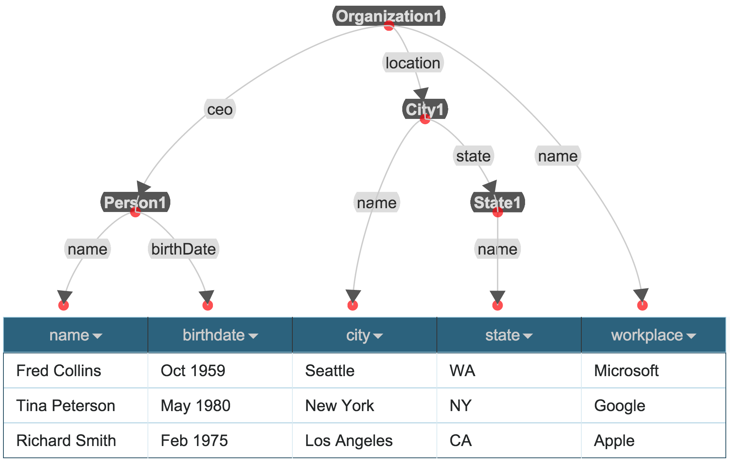
Result in Karma

Slide 72
Refining the Model
Impose constraints on Steiner Tree Algorithm
Change weight of selected links to ε
Add source and target of selected link to Steiner nodes
Correct Model
date

Slide 73
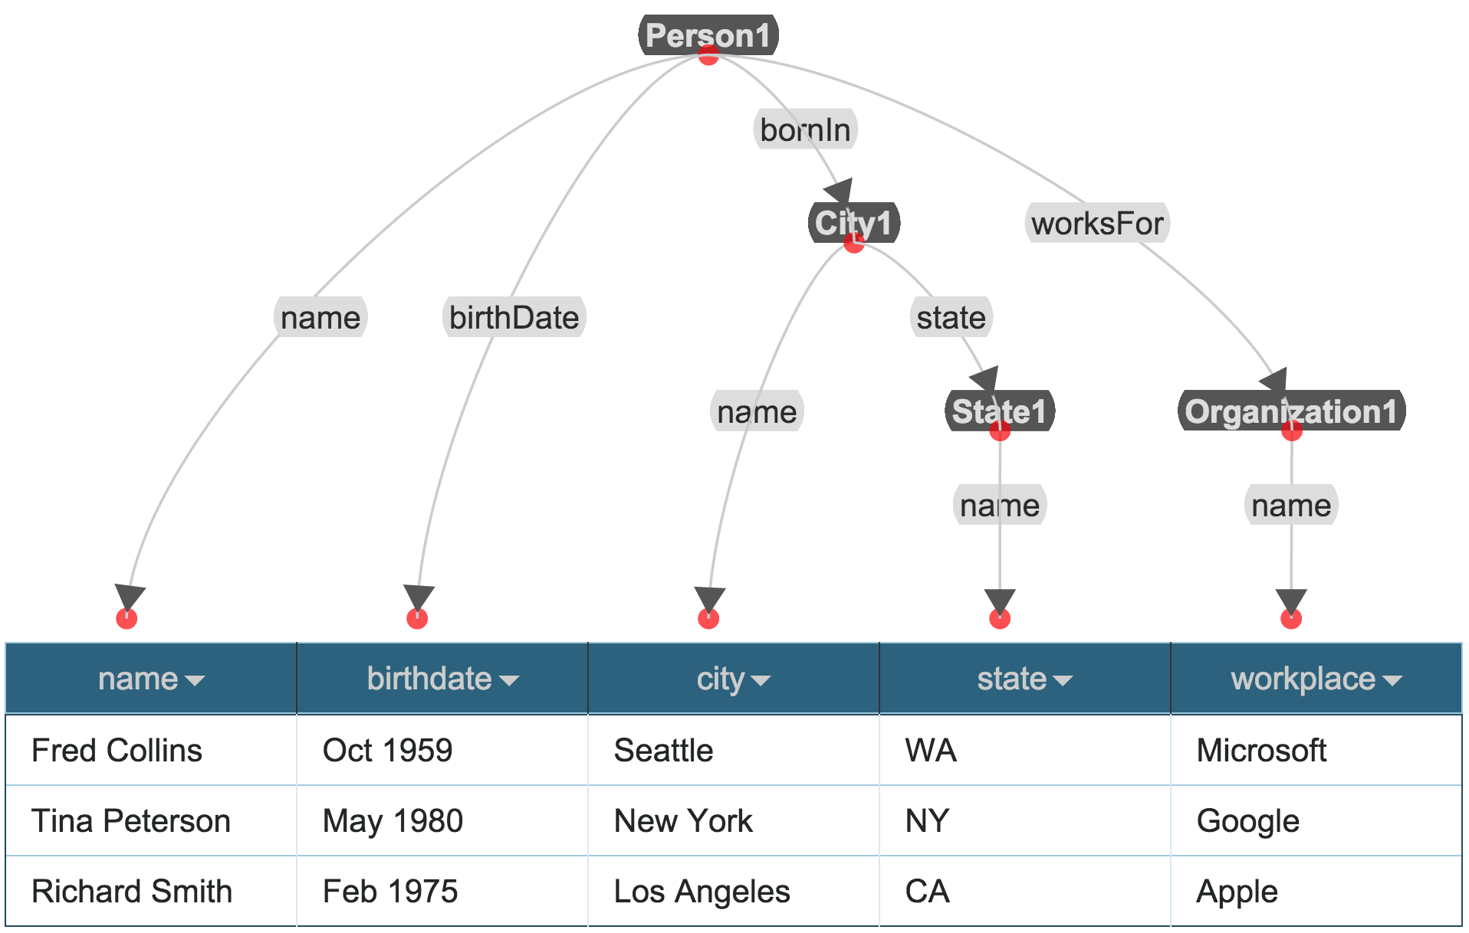
Final Semantic Model

Slide 74

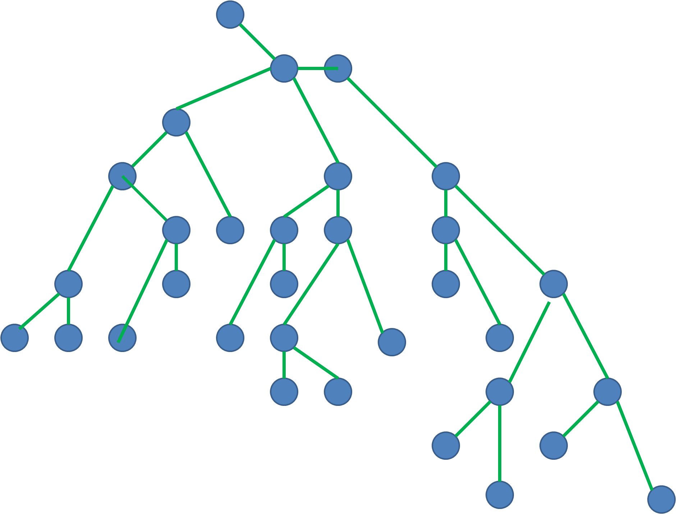
Karma Learns the Source Models Taheriyan et al., ISWC 2013, ICSC 2014
Sample Data
Learn
Semantic Types
Generate Candidate Models
Construct a Graph
Domain Ontology
Known Semantic Models
Rank Results

Slide 75
Karma Use Cases
University of Southern California
Pedro Szekely and Craig Knoblock

Slide 76
Source Mapping Phase
Domain Model
Domain
Expert
Source Mappings
Karma
Samples of Source Data
Mapping Phase
University of Southern California
Pedro Szekely and Craig Knoblock

Slide 77
Source Mapping and Query Time
Domain Model
Domain
Expert
Source Mappings
Karma
Samples of Source Data
Mapping Phase
Query Phase
Karma Runtime
System
Query
Data Warehousing
Analyst
Virtual Integration
University of Southern California
Pedro Szekely and Craig Knoblock

Slide 78

VIVO
VIVO is a system to build researcher networks across institutions
Used Karma to map the data about USC faculty to VIVO ontology and publish it as RDF
VIVO ingest the RDF data
Video

Slide 79
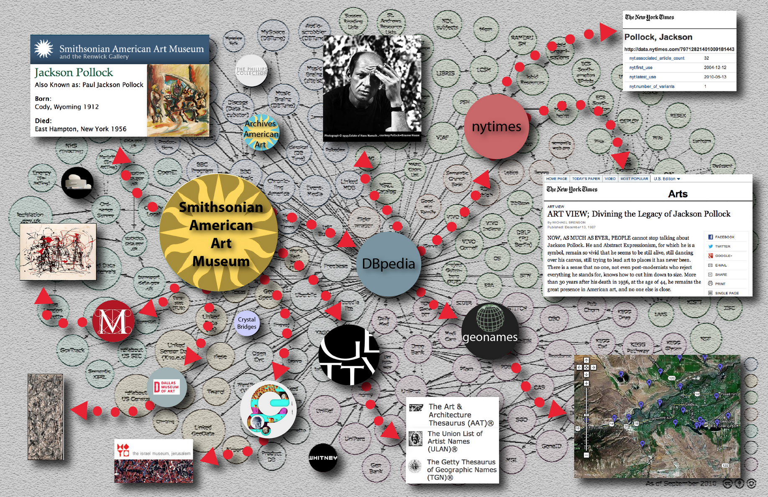
American Art Collaborative [Knoblock et al., ISWC 2017]
Used Karma to convert data of 13 American Art Museums to Linked Open Data
Modeled according to CIDOC-CRM Ontology
Linked the generated RDF to DBPedia and ULAN
Video
Notes:
linked to DBpedia, the Getty Union List of Artist Names (ULAN)® and the NY Times Linked Data

Slide 80
Using Karma to map museum data to the CIDOC CRM ontology
https://www.youtube.com/watch?v=h3_yiBhAJIc

Slide 81
Related Work
Mapping Databases into RDF
D2R & R2R [Bizer & Cyganiak, 2006, Bizer & Shultz, 2010]
Semion [Nuzzolese, Gangemi, Presutti, & Ciancarini, 2010]
Maps a database into RDF using the DB schema
Mannually defines the mappings of triples to another ontology
Ontology Matching
[Doan et al., 2000]
Learn mappings to the ontology using data, but would be analogous to just doing the semantic typing
Schema Matching
[Rahm et al., 2001]
Generates alignments between schemas, not a fine-grained model of the data
Semantic Integration of Bioinformatics Data
Bio2RDF [Belleau et al., 2008]
Manual conversion of sources into RDF

Slide 82
Related Work
Writing semantic descriptions by hand
R2RML, SWRL
Tedious and time-consuming task
Requires expertise in SW technologies
Semantic annotation of Web services and Web tables
Very limited in learning the relationships
Learning Semantic Definitions of Online Information Sources [Carman, Knoblock, 2007]
Learns LAV rules from known sources
Can only learn descriptions that overlap known sources
University of Southern California
Mohsen Taheriyan

Slide 83
Discussion
Automatically build rich semantic descriptions of data sources
Exploit the background knowledge from (i) the domain ontology, and (ii) the known source models
Semantic descriptions are the key ingredients to automate many tasks, e.g.,
Source Discovery
Data Integration
Service Composition
University of Southern California
Mohsen Taheriyan

Slide 84
More Info
karma.isi.edu

